Slide 1
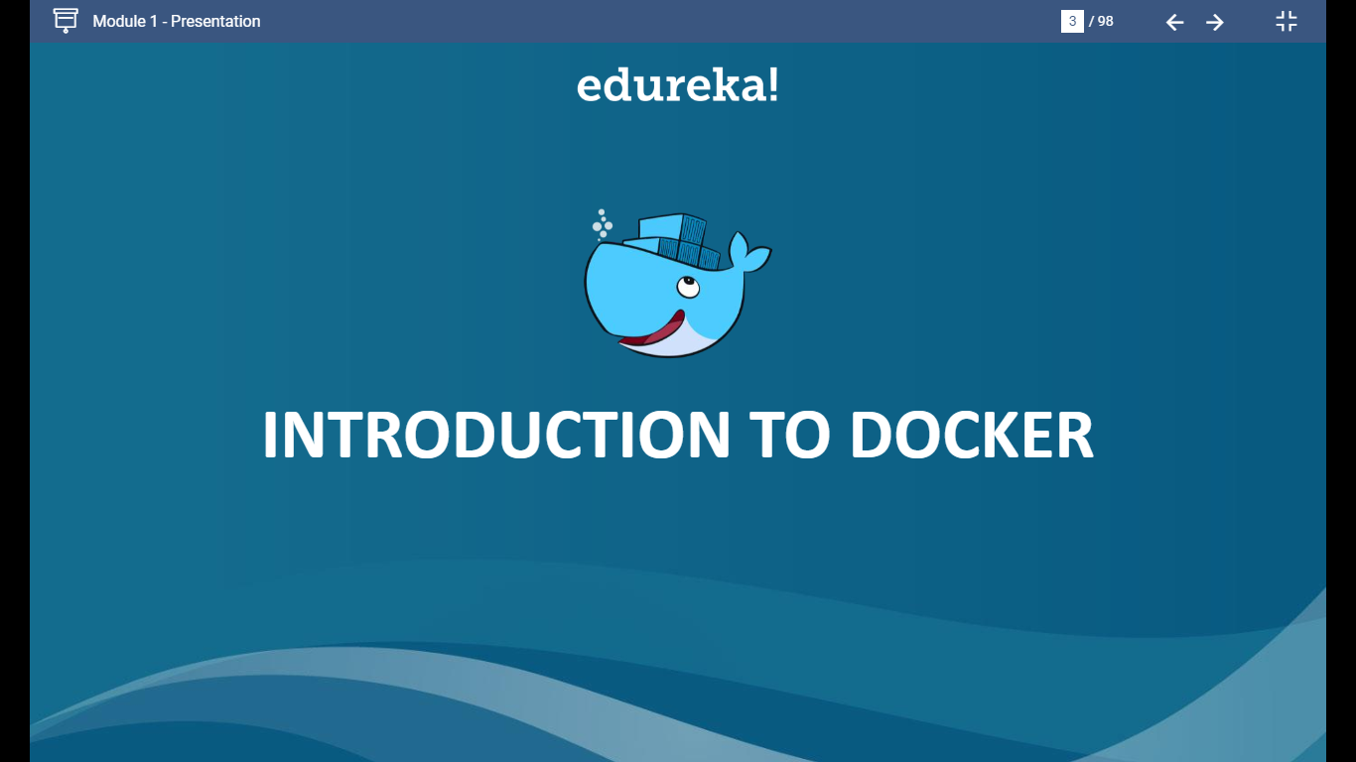

Slide 2
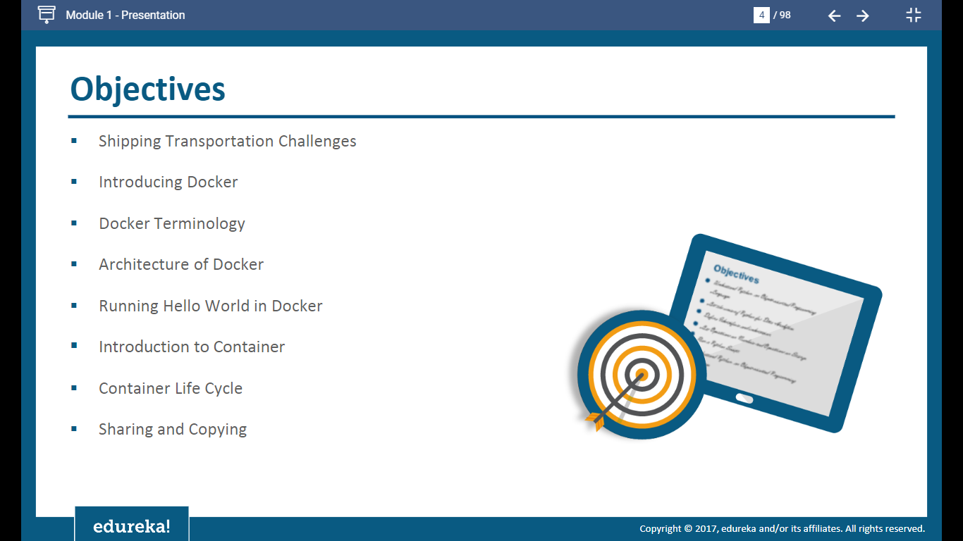

Slide 3
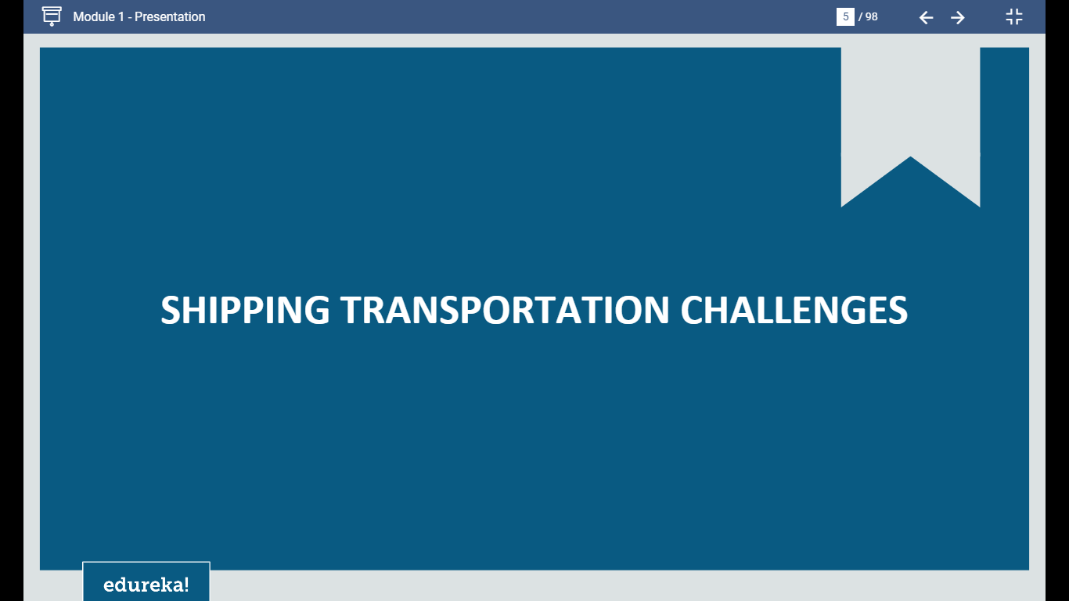

Slide 4
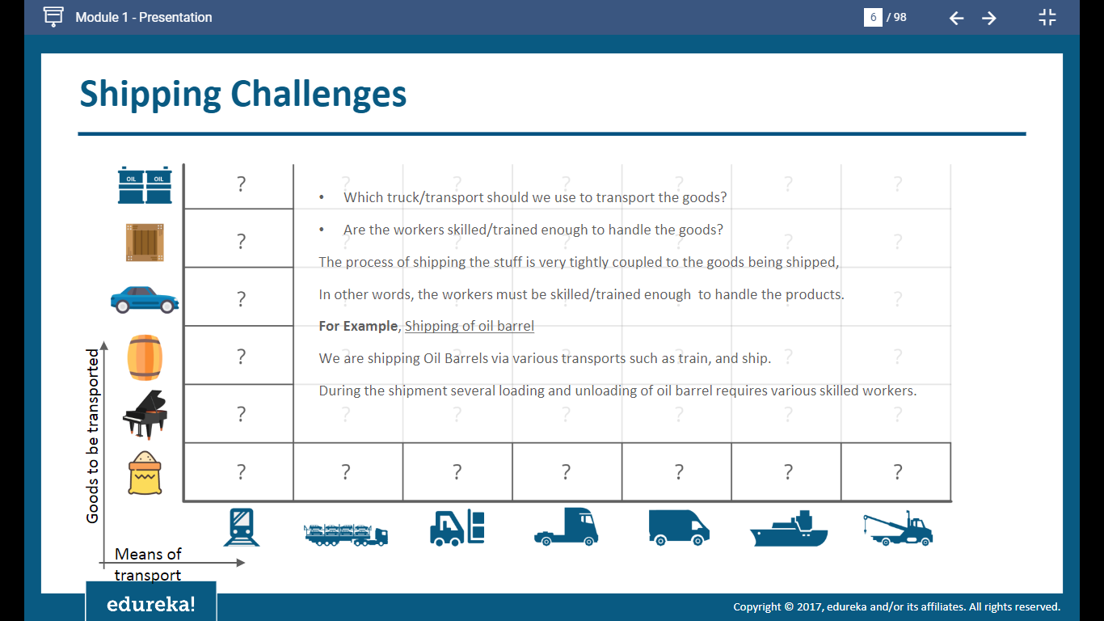

Slide 5
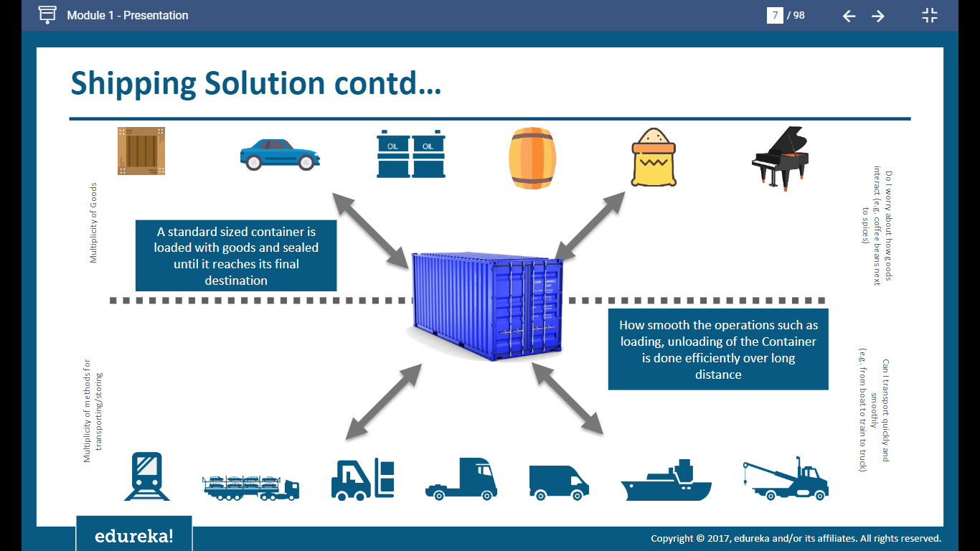

Slide 6
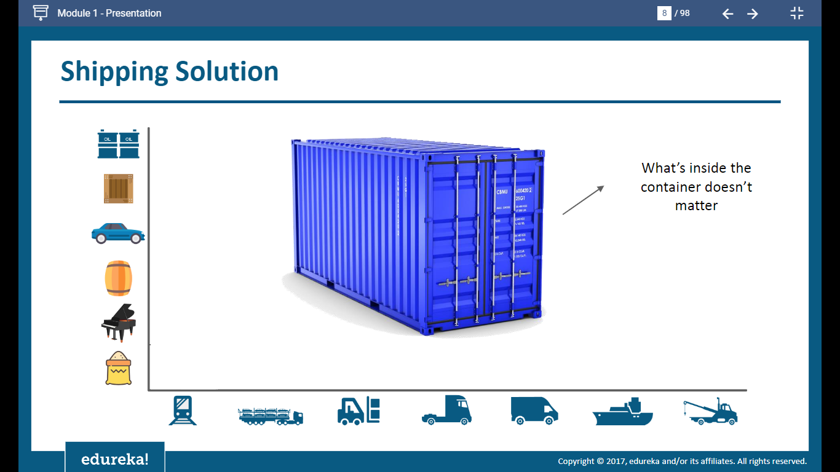

Slide 7
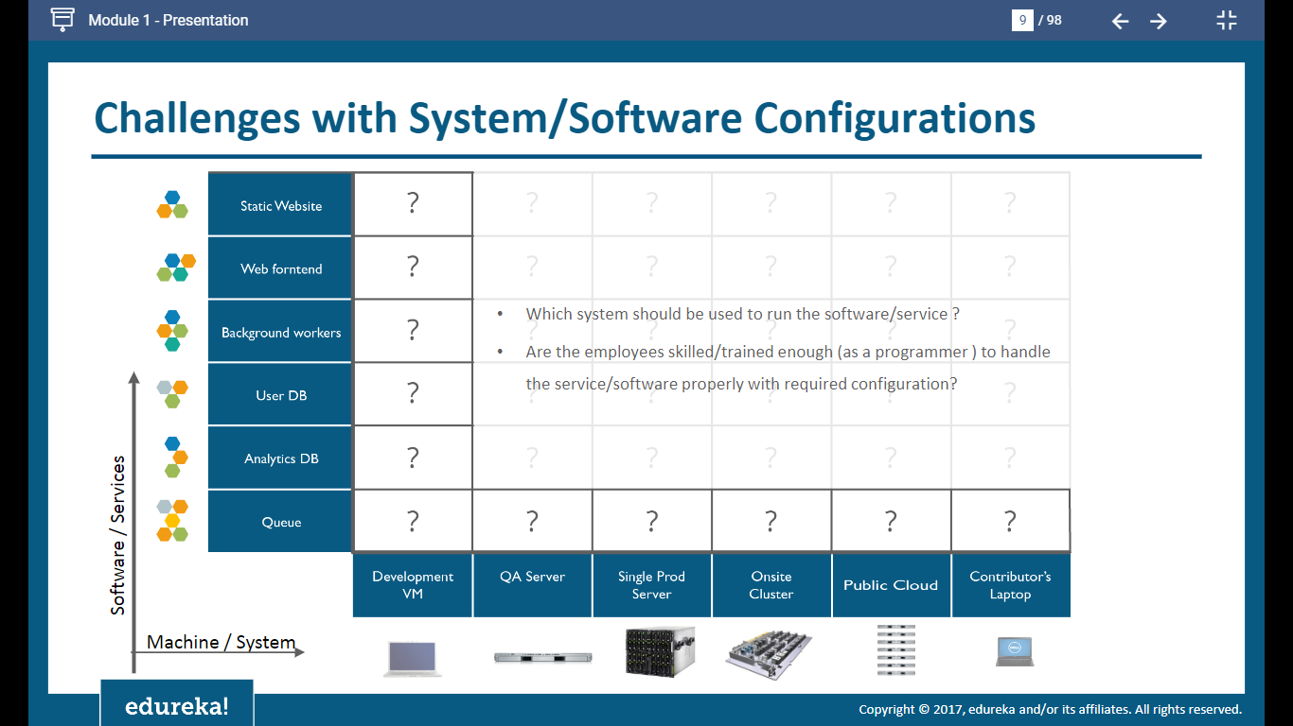

Slide 8
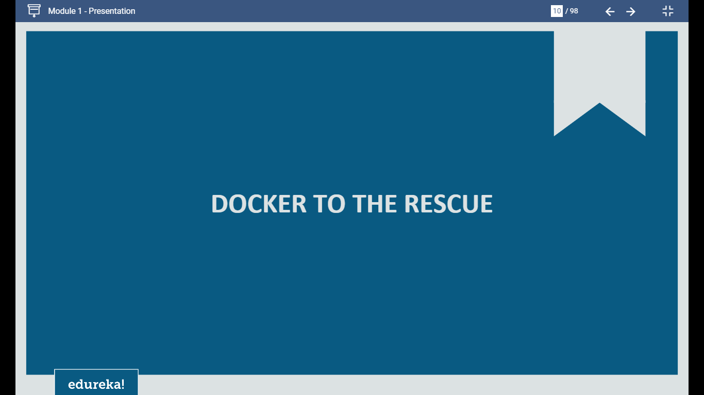

Slide 9
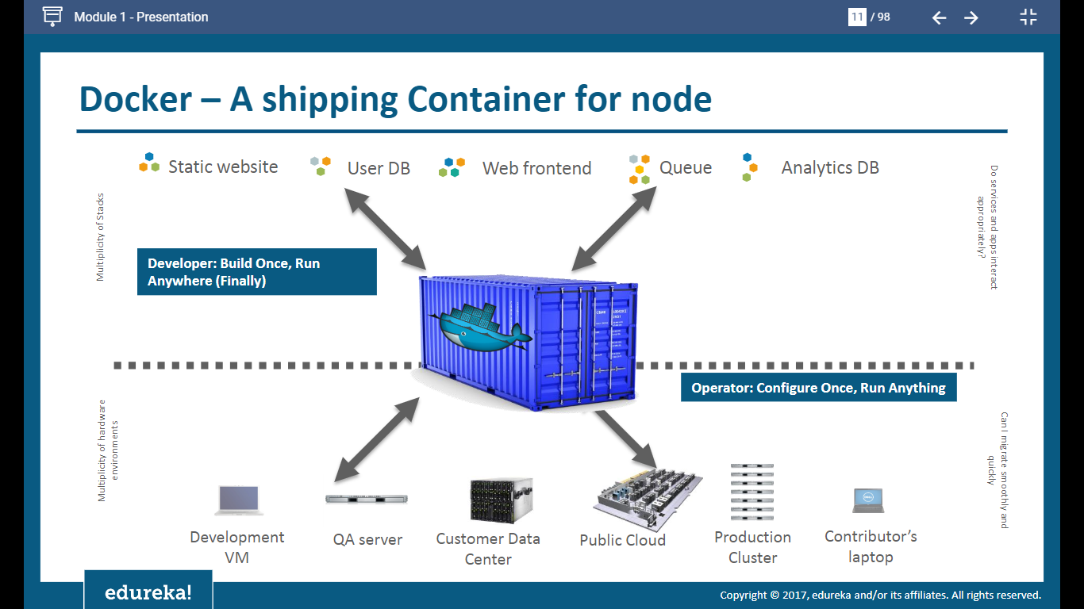

Slide 10
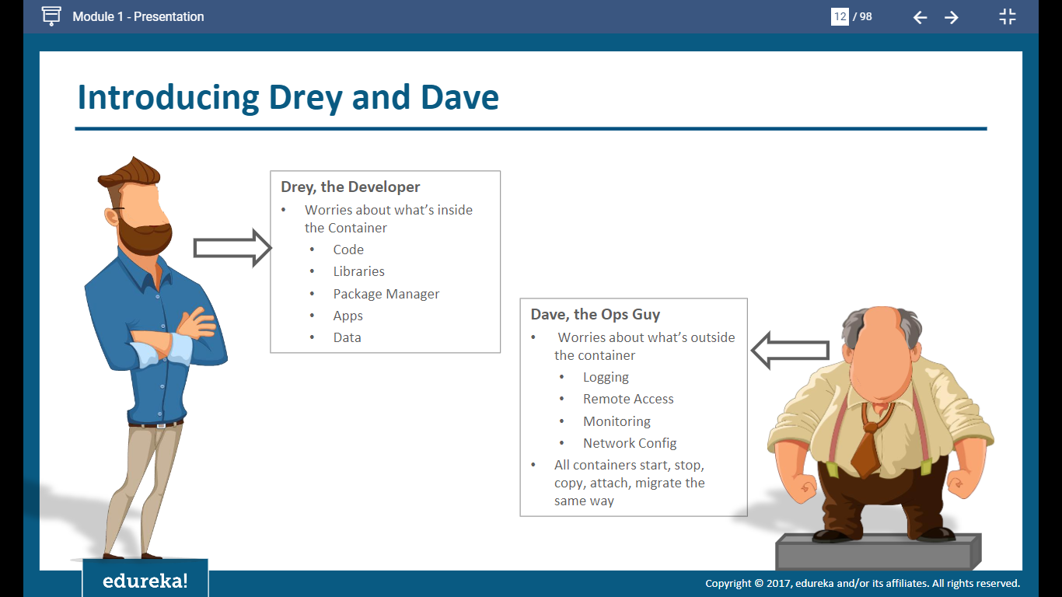

Slide 11
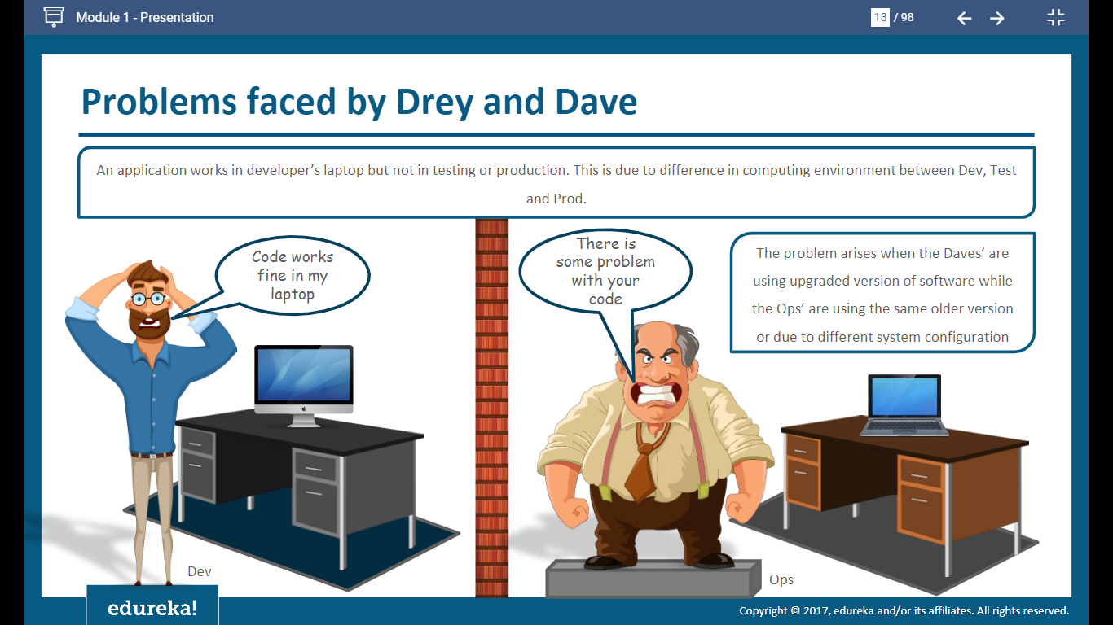

Slide 12
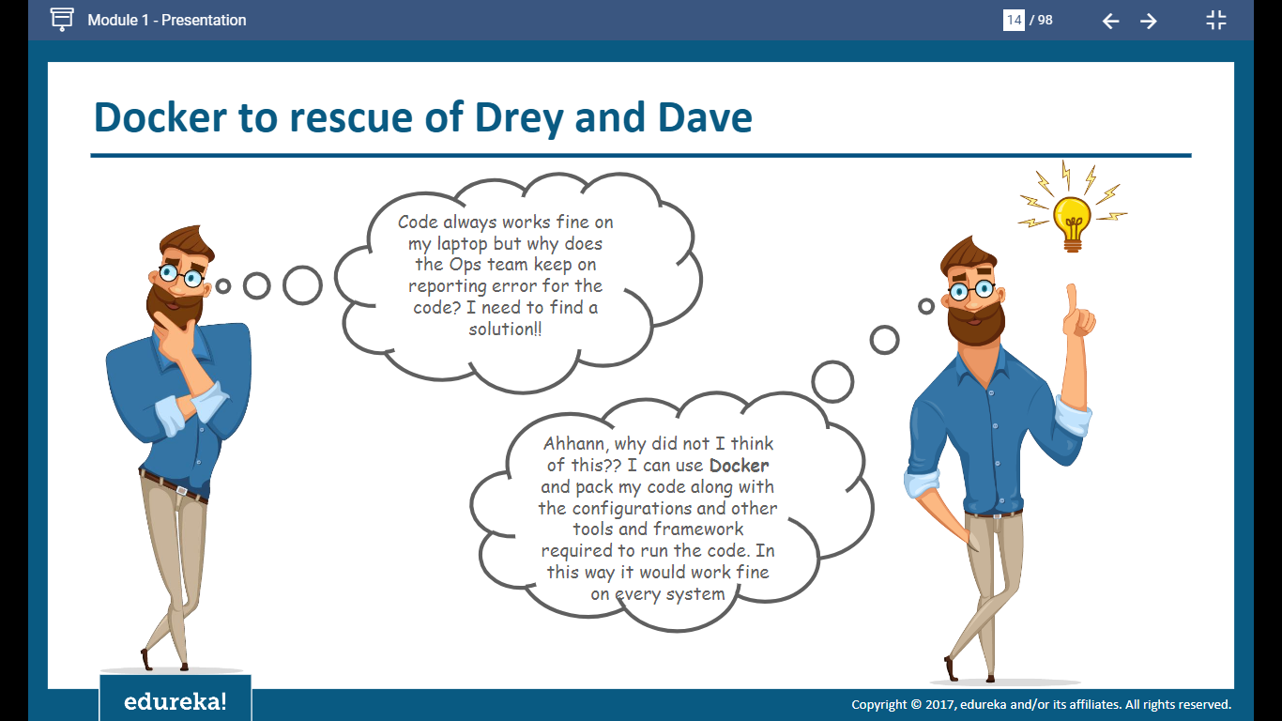

Slide 13
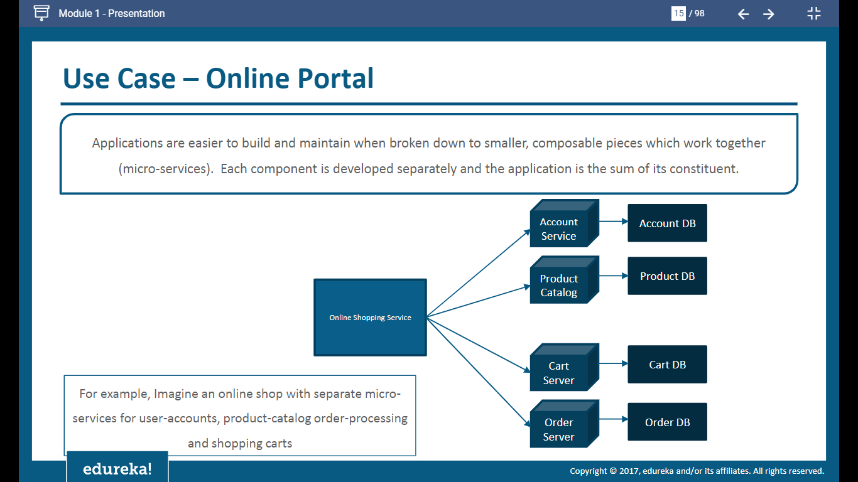

Slide 14
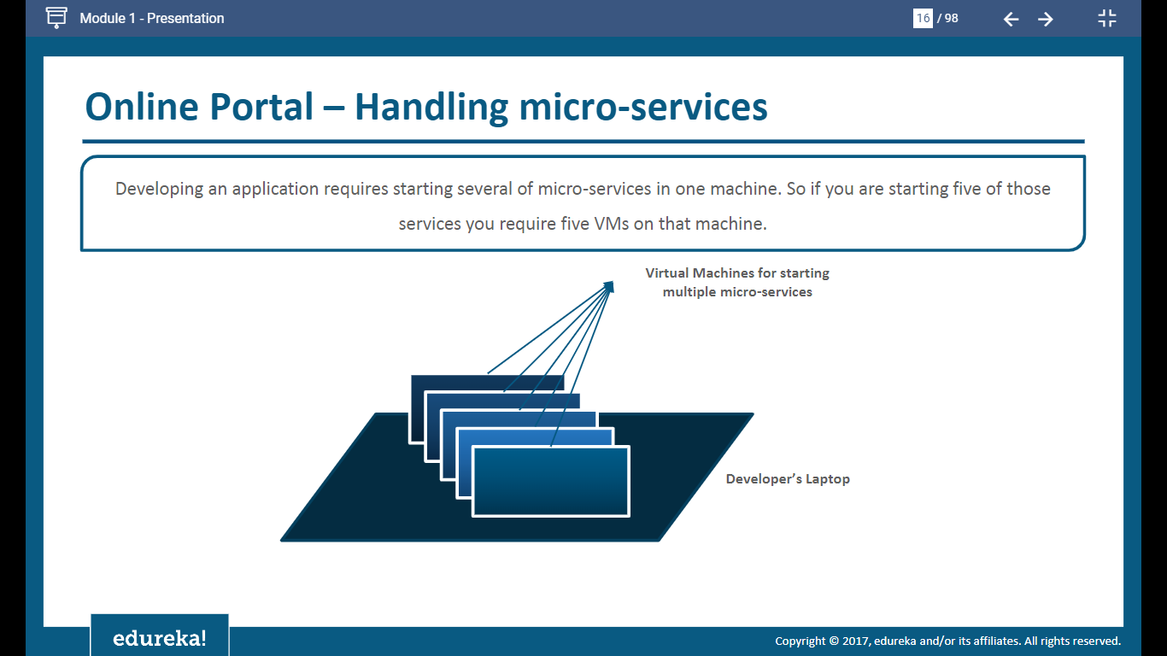

Slide 15
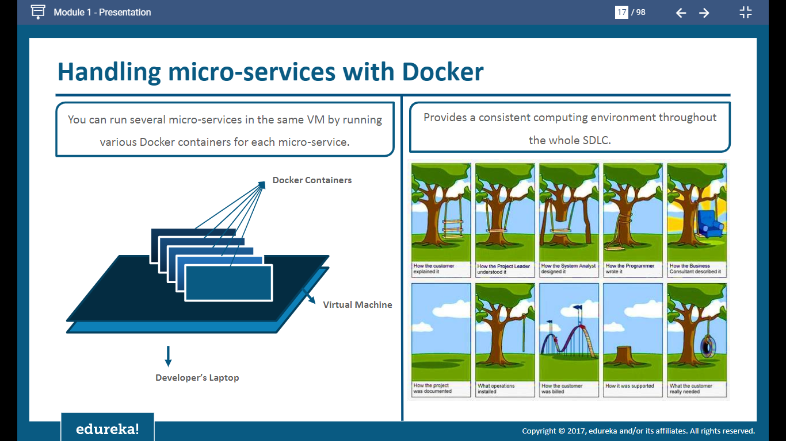

Slide 16
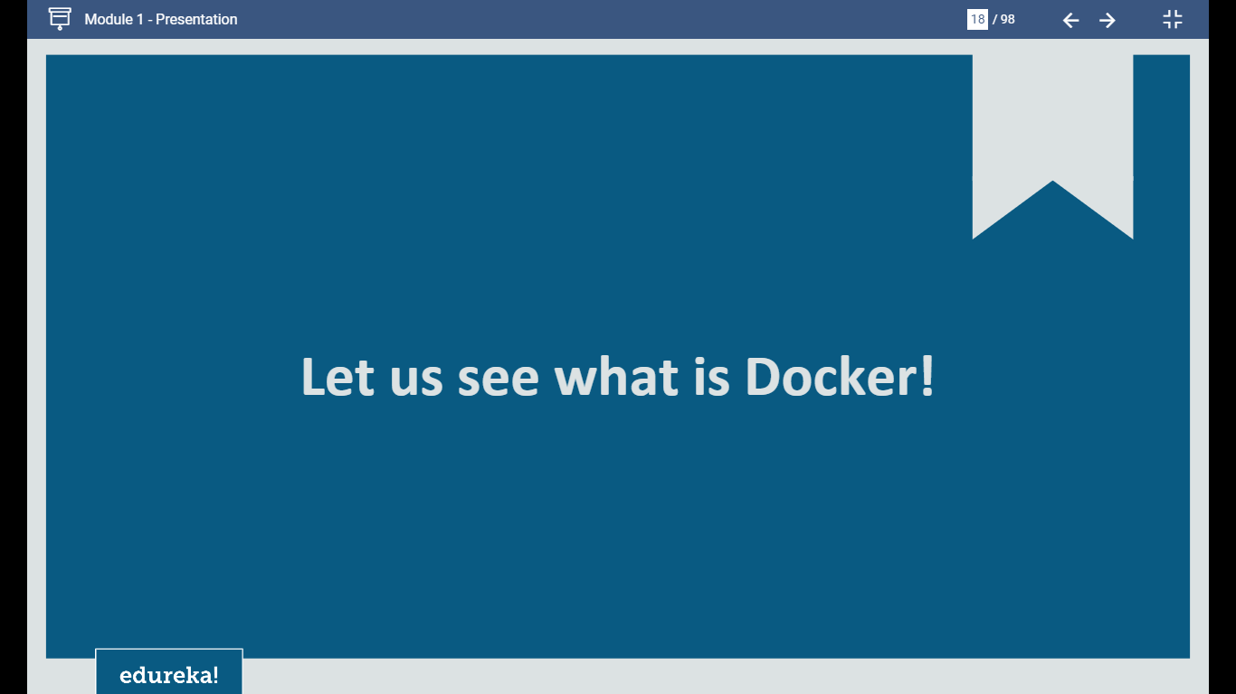

Slide 17
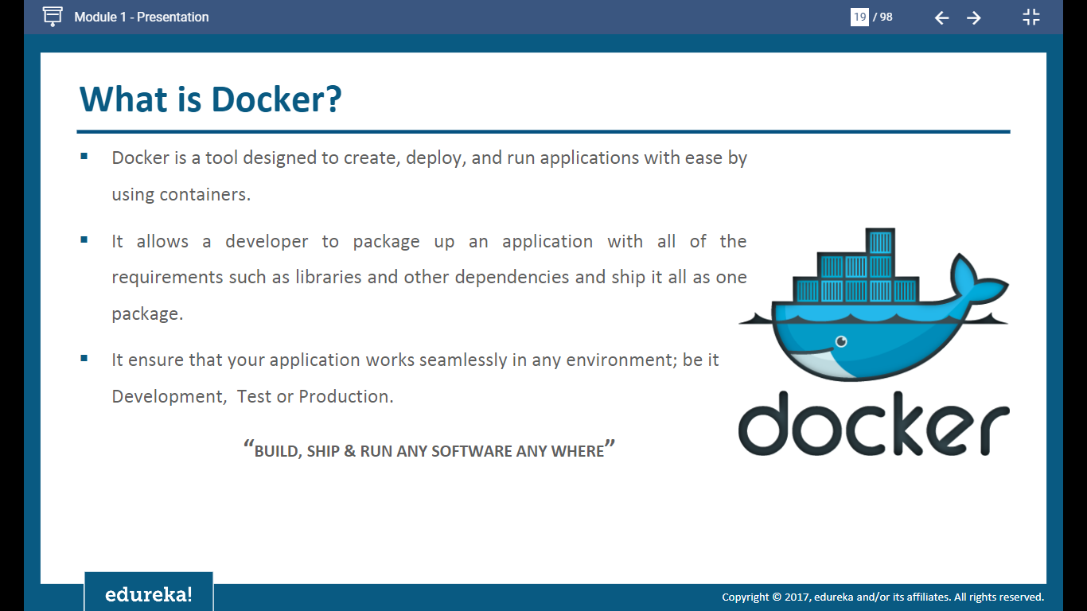

Slide 18
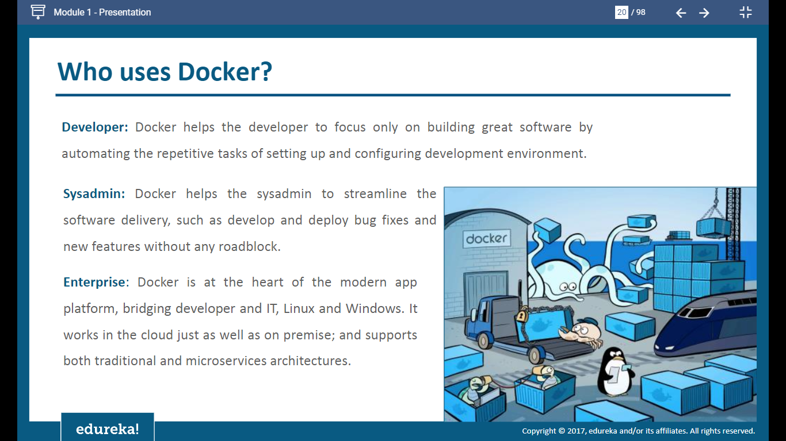

Slide 19
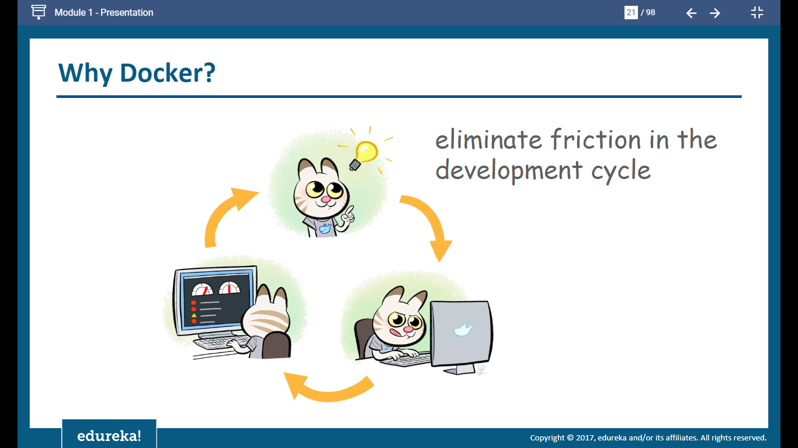

Slide 20
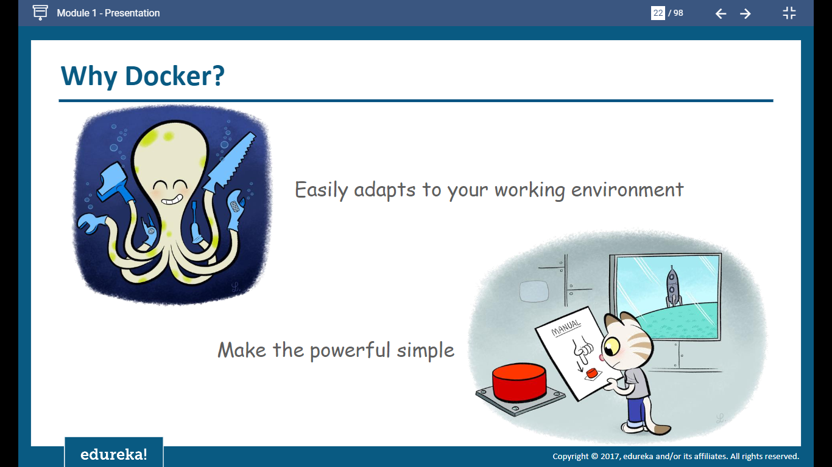

Slide 21
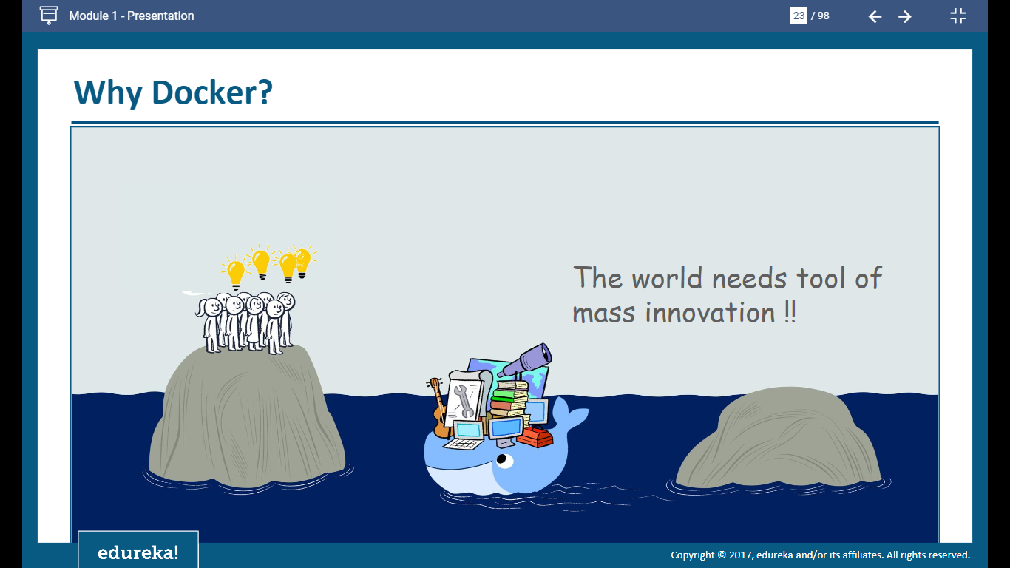

Slide 22
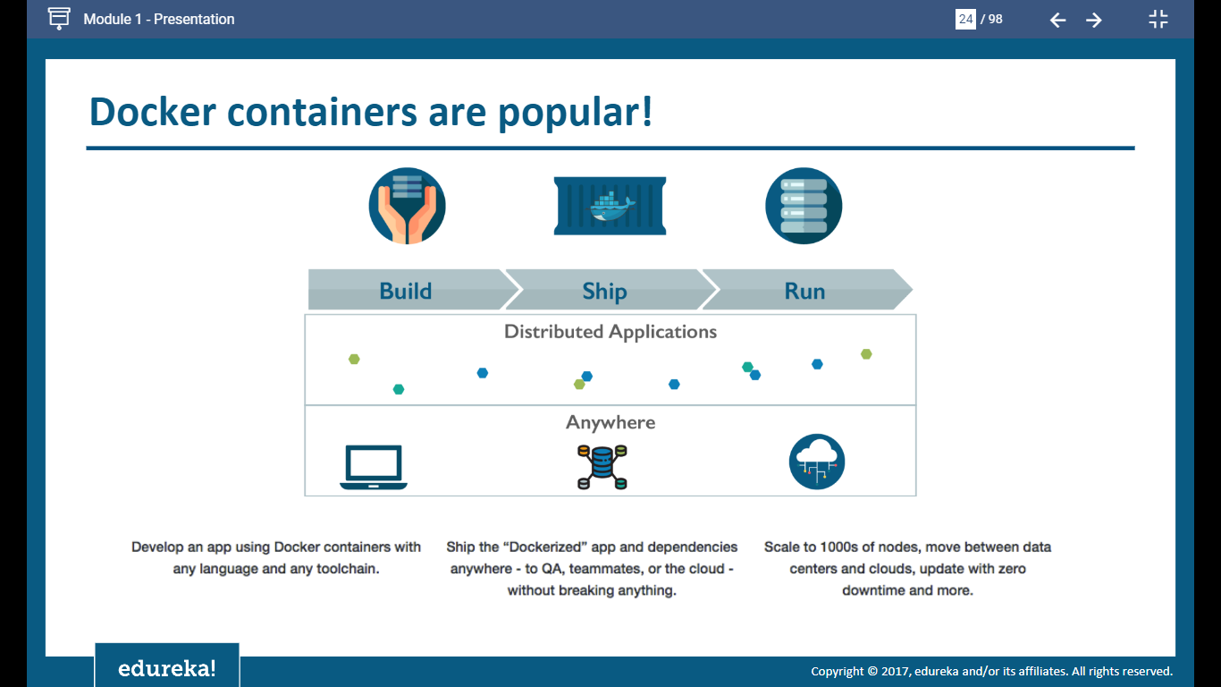

Slide 23
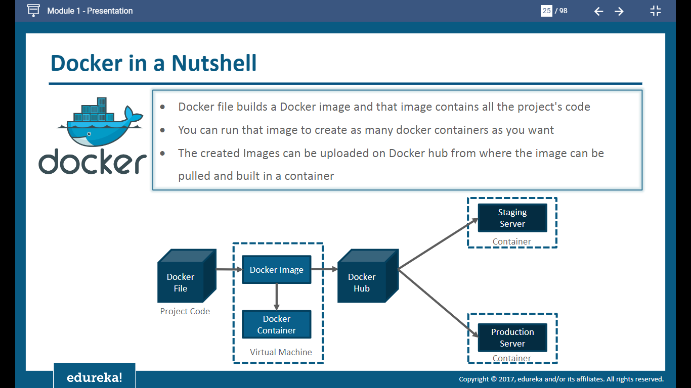

Slide 24
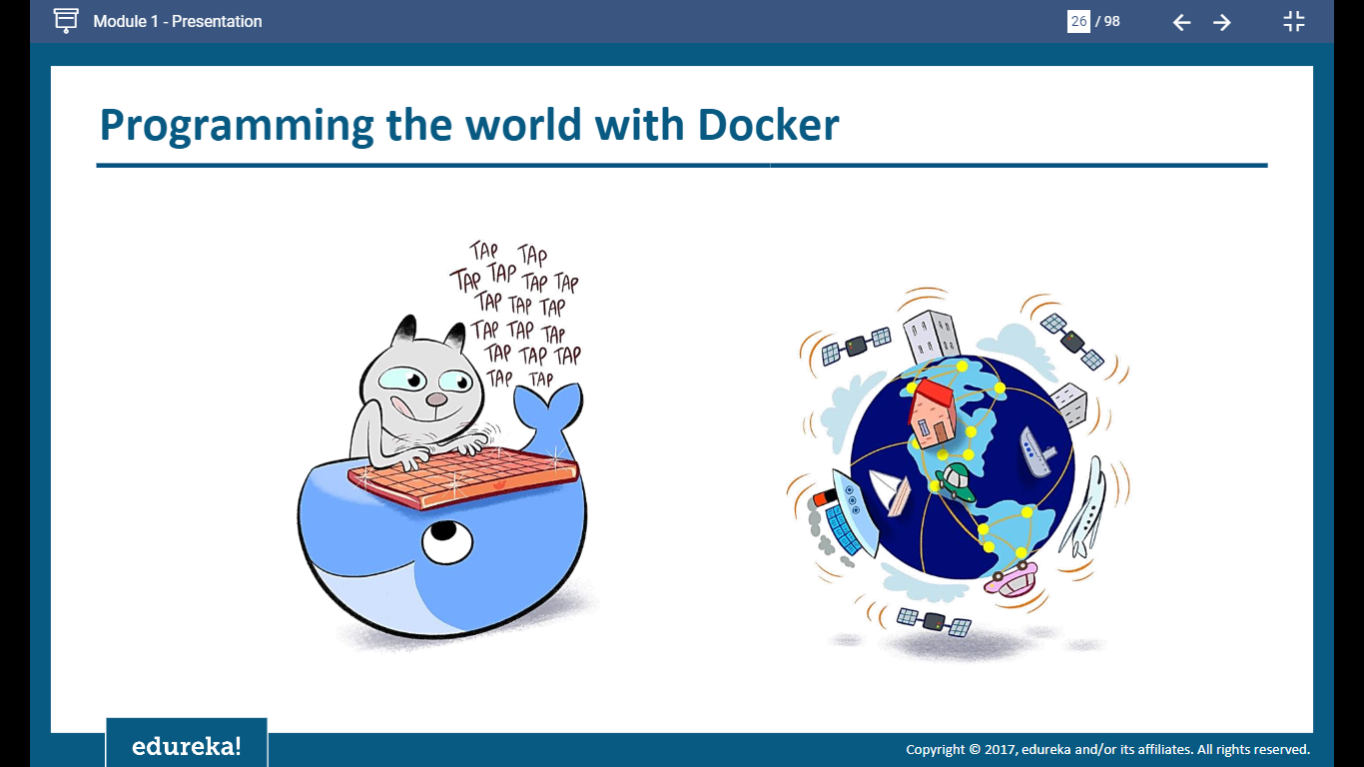

Slide 25
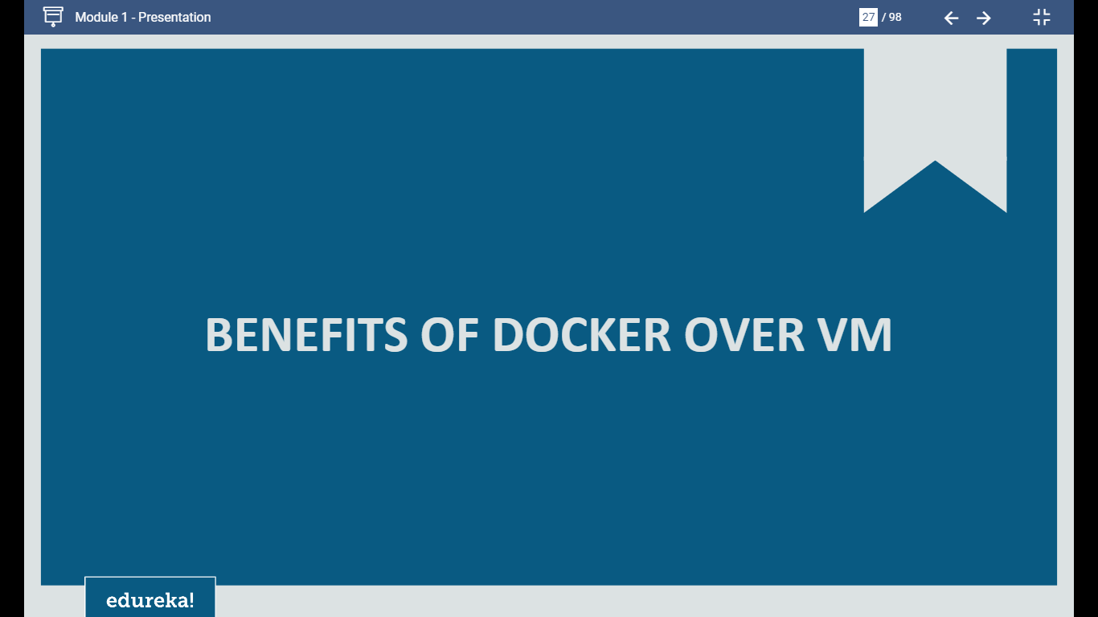

Slide 26
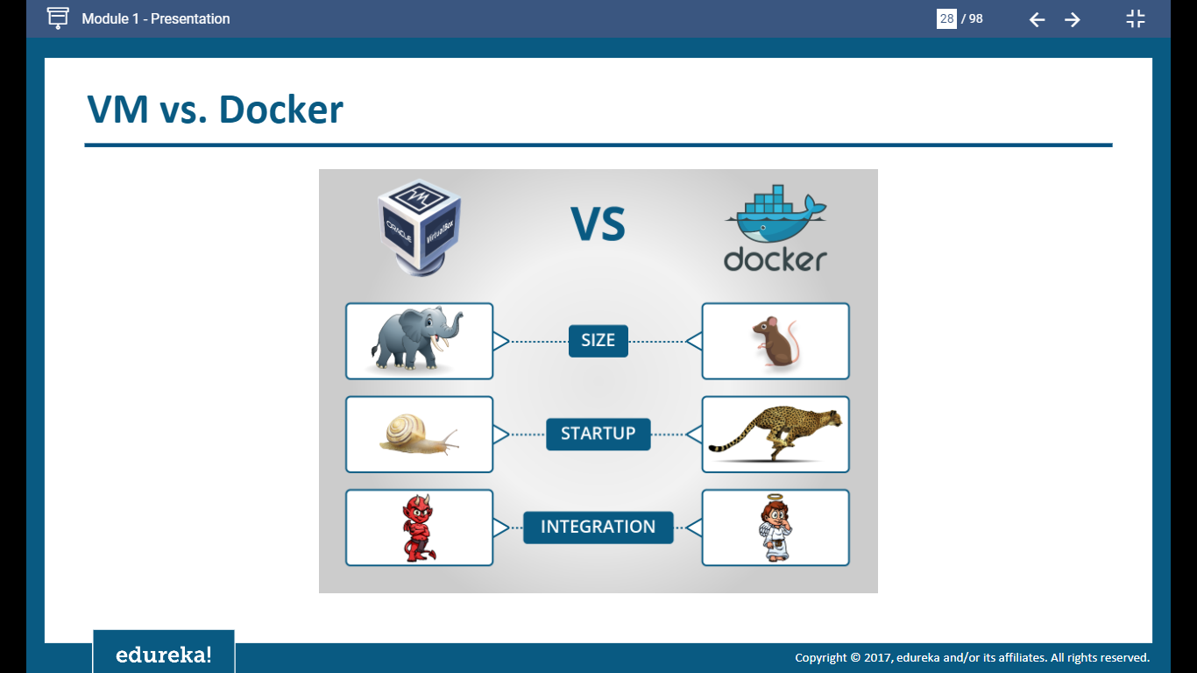

Slide 27
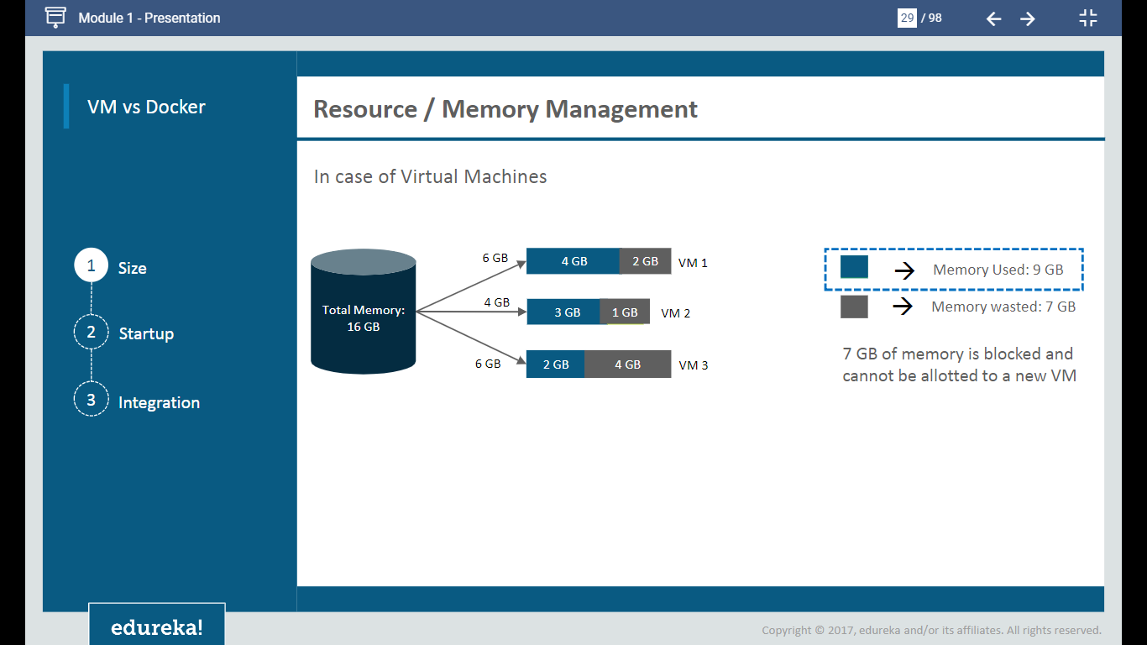

Slide 28
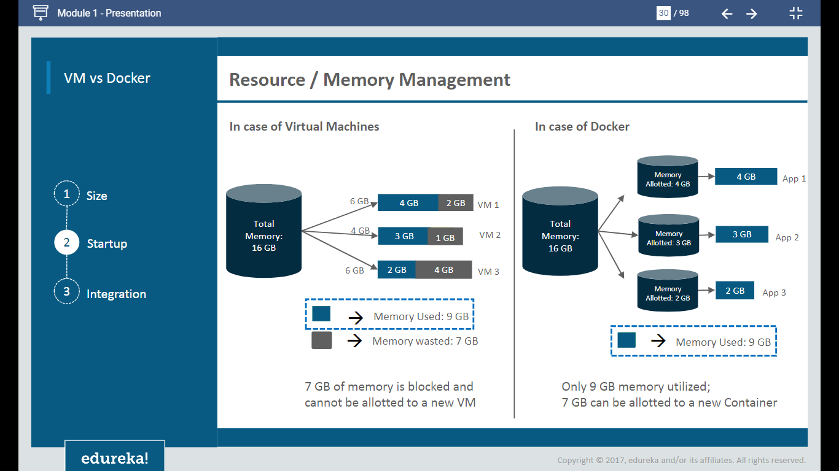

Slide 29
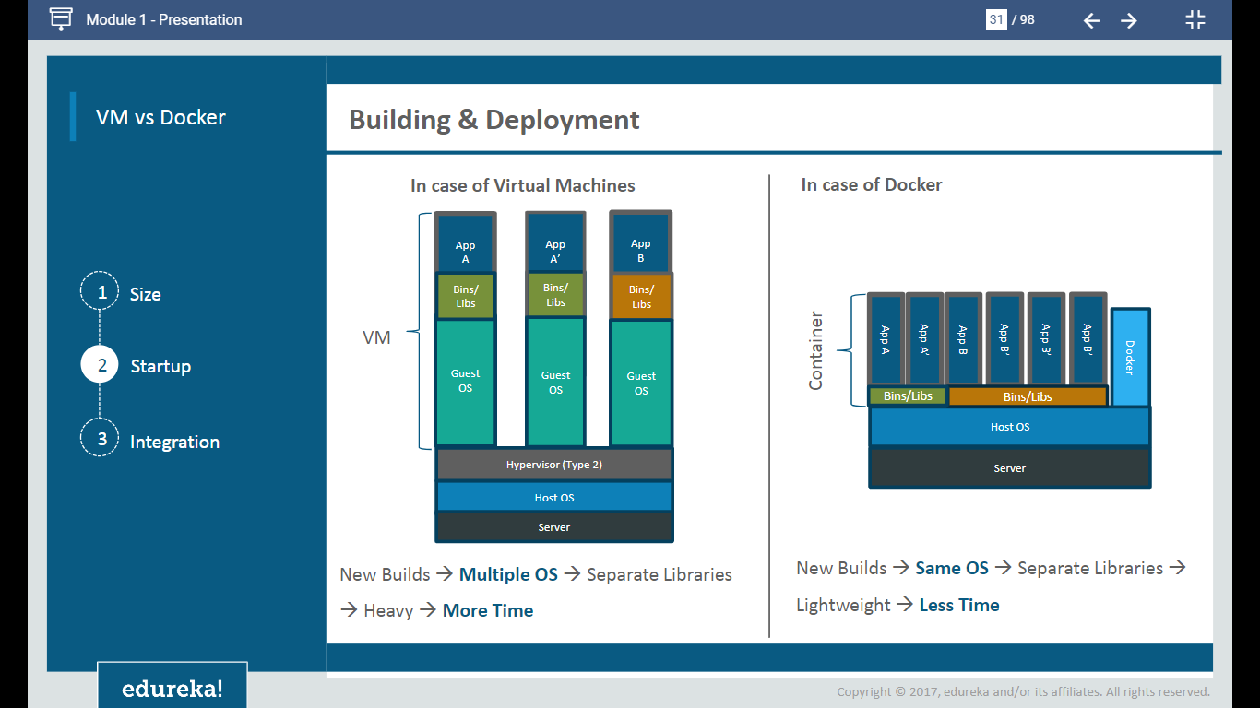

Slide 30
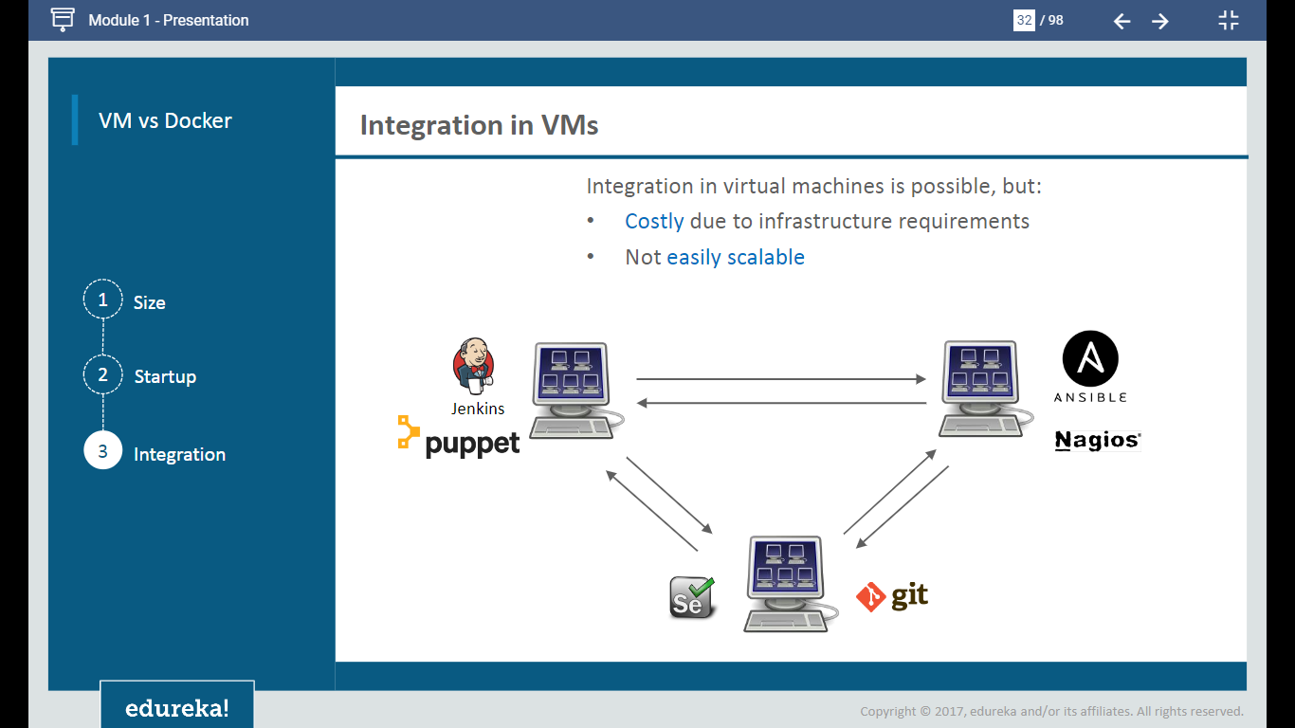

Slide 31
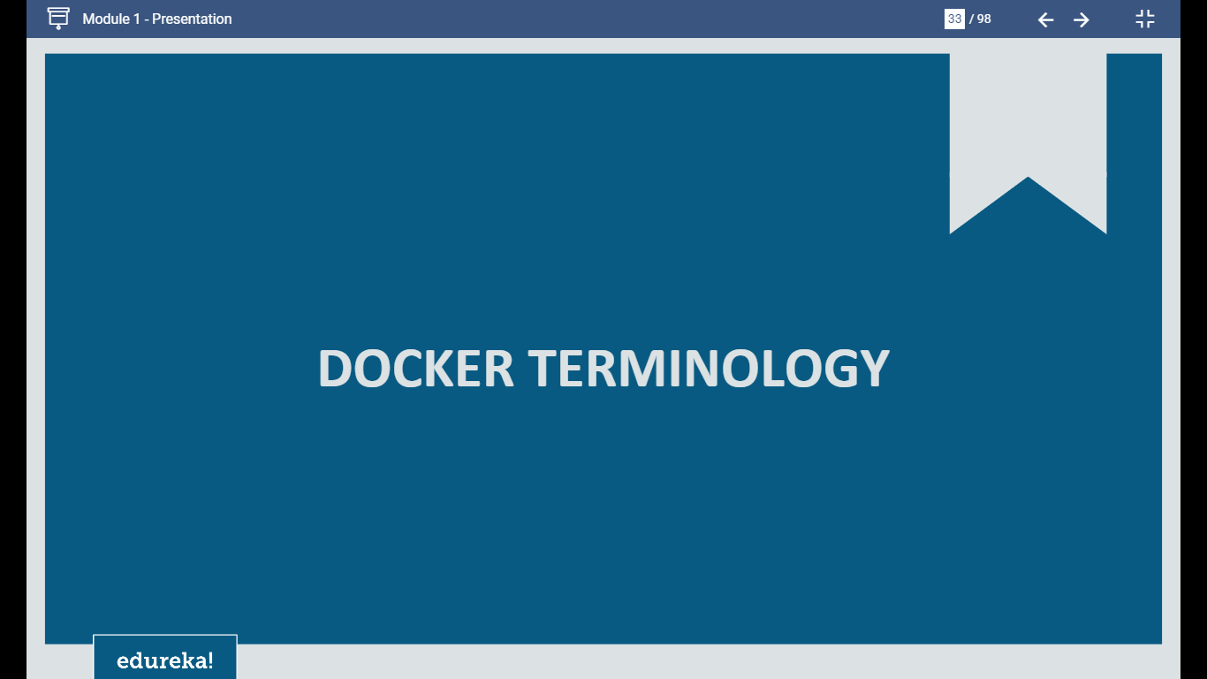

Slide 32
Docker Components
Docker Daemon
Docker Client
Docker Registry
Docker Images
Docker Containers

Slide 33
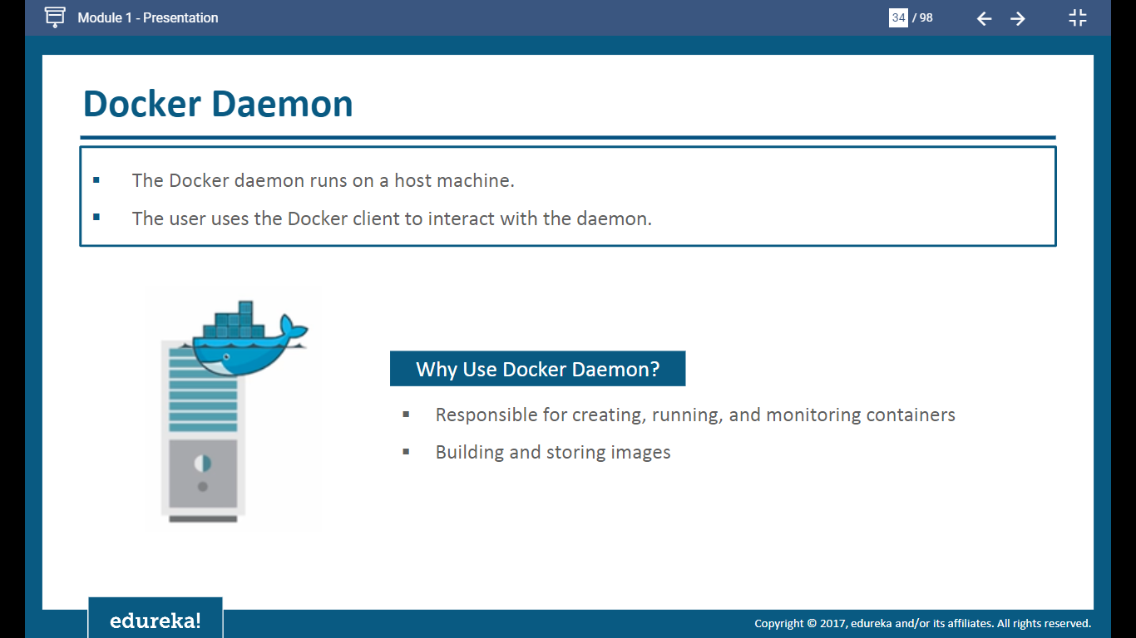

Slide 34
Docker Daemon
On a typical installation the Docker daemon is started by a system utility, not manually by a user. This makes it easier to automatically start Docker when the machine reboots.
If you don’t want to use a system utility to manage the Docker daemon, or just want to test things out, you can manually run it using the “dockerd” command. You may need to use “sudo” depending on your operating system configuration.
When you start Docker this way, it runs in the foreground and sends its logs directly to your terminal.
To stop Docker when you have started it manually, issue a “Ctrl+C” in your terminal.

Slide 35
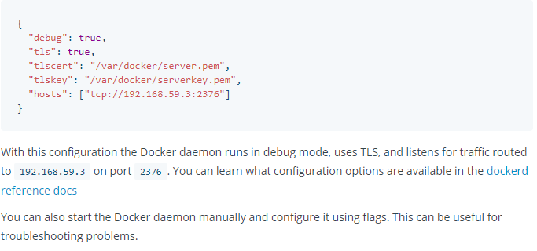
Configure the Docker Daemon
There are two ways to configure the Docker daemon:
Use a JSON configuration file. This is the preferred option, since it keeps all configurations in a single place.
Use flags when starting “dockerd”
You can use both of these options together as long as you don’t specify the same option both as a flag and in the JSON file. If that happens, the Docker daemon won’t start and prints an error message.
To configure the Docker daemon using a JSON file, create a file at /etc/docker/daemon.json on Linux systems. Here’s what the configuration file looks like:

Slide 36
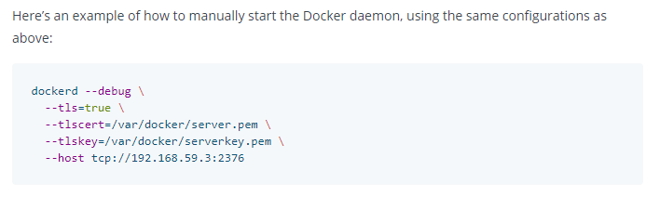
Configure the Docker Daemon

Slide 37
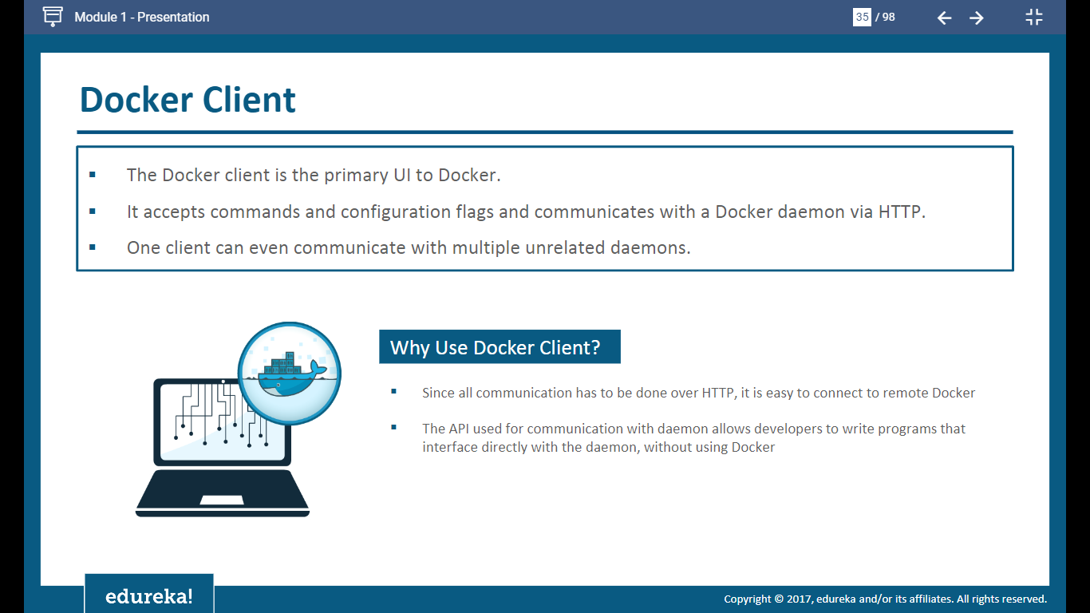

Slide 38
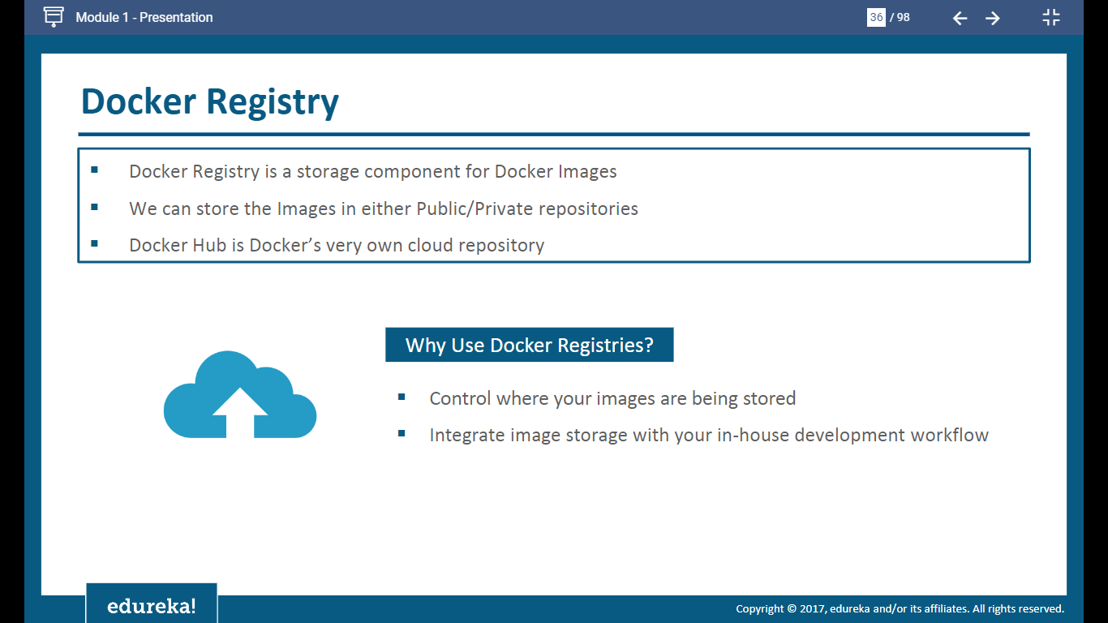

Slide 39
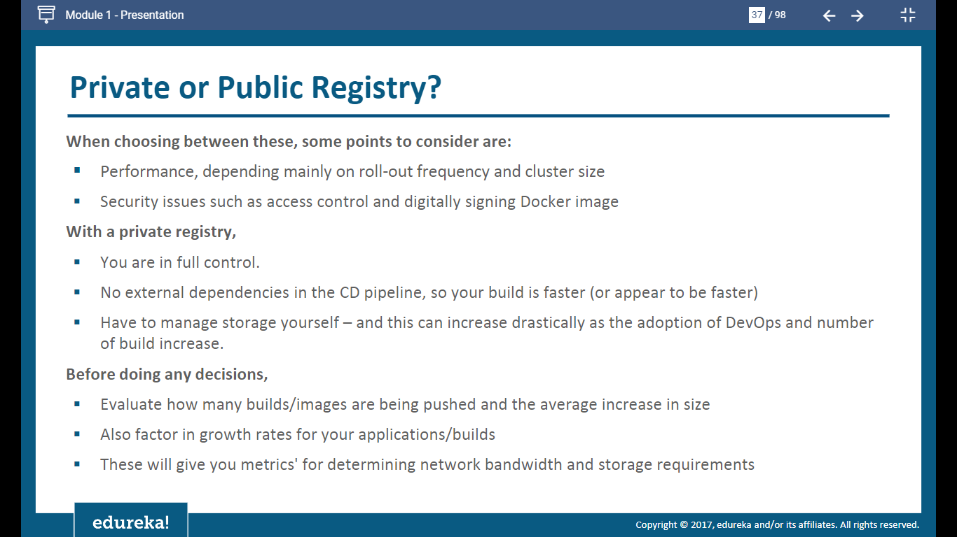

Slide 40
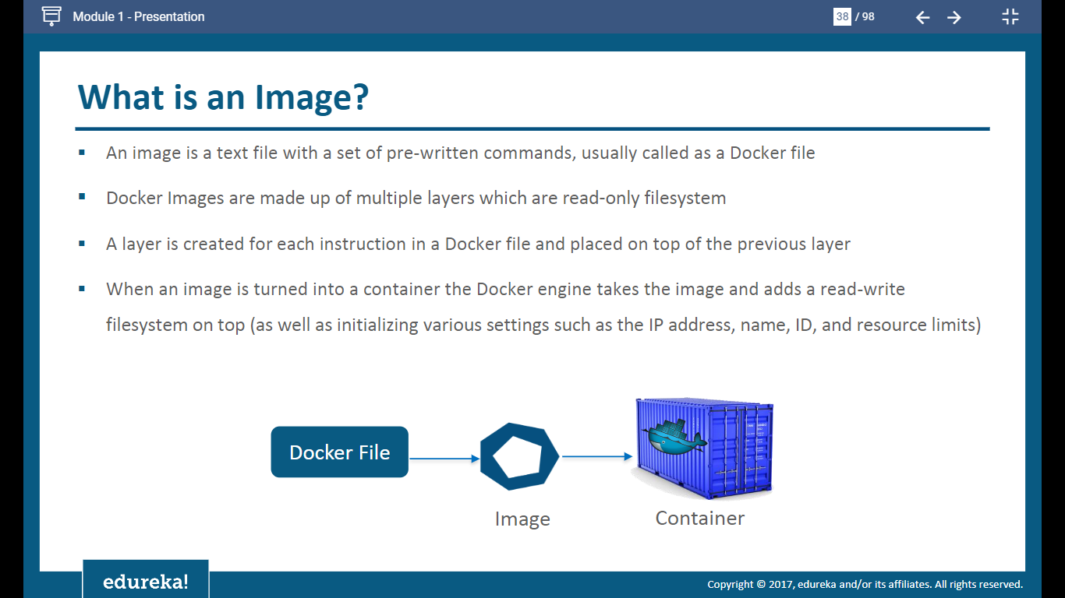

Slide 41
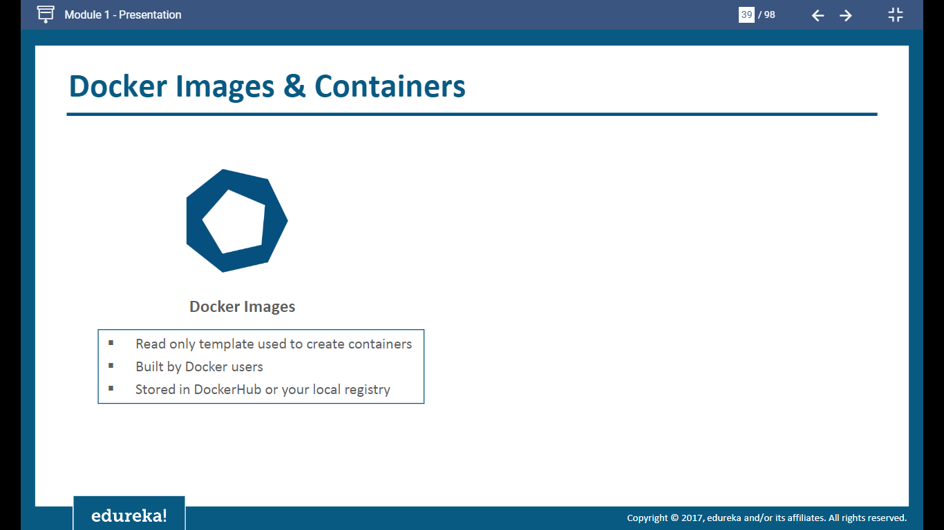

Slide 42
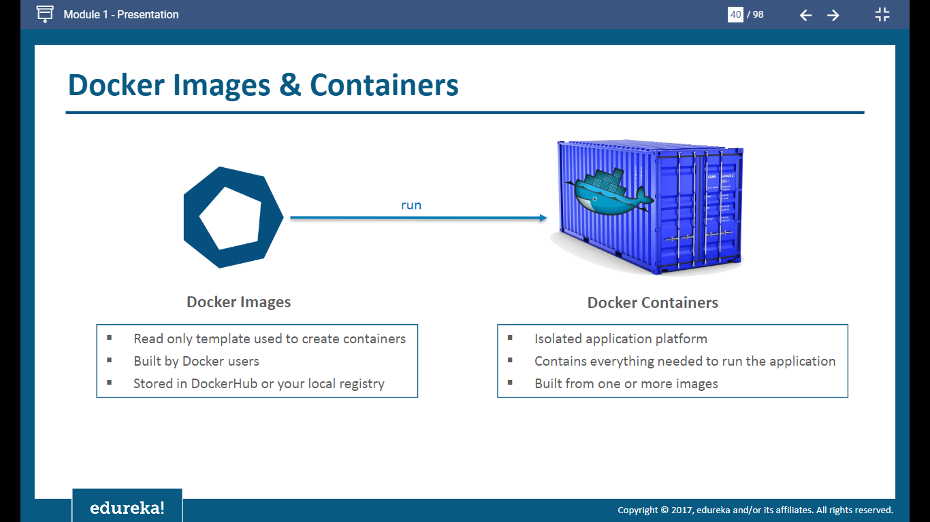

Slide 43
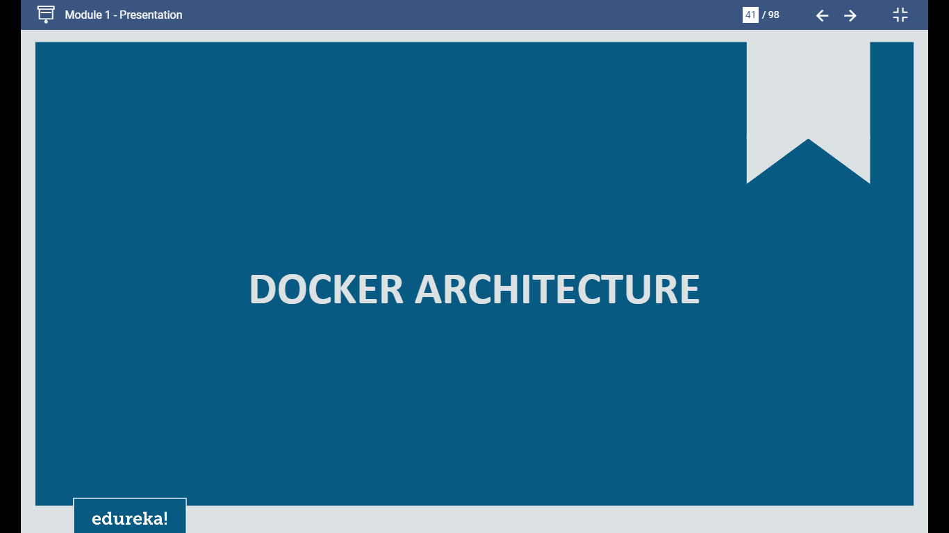

Slide 44
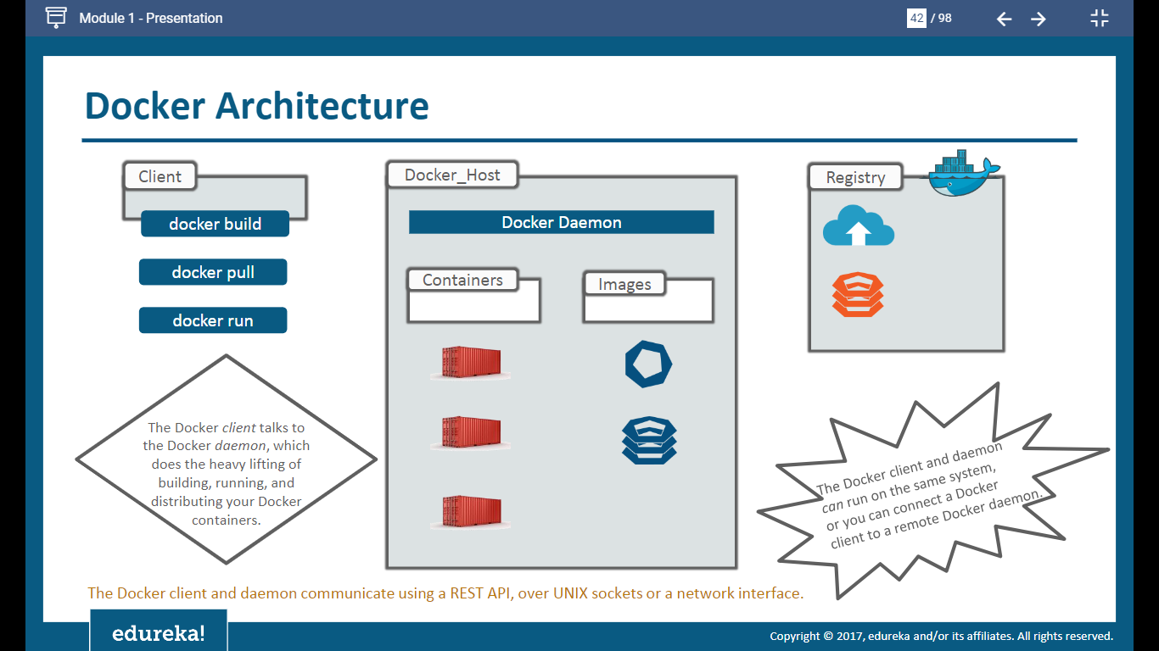

Slide 45
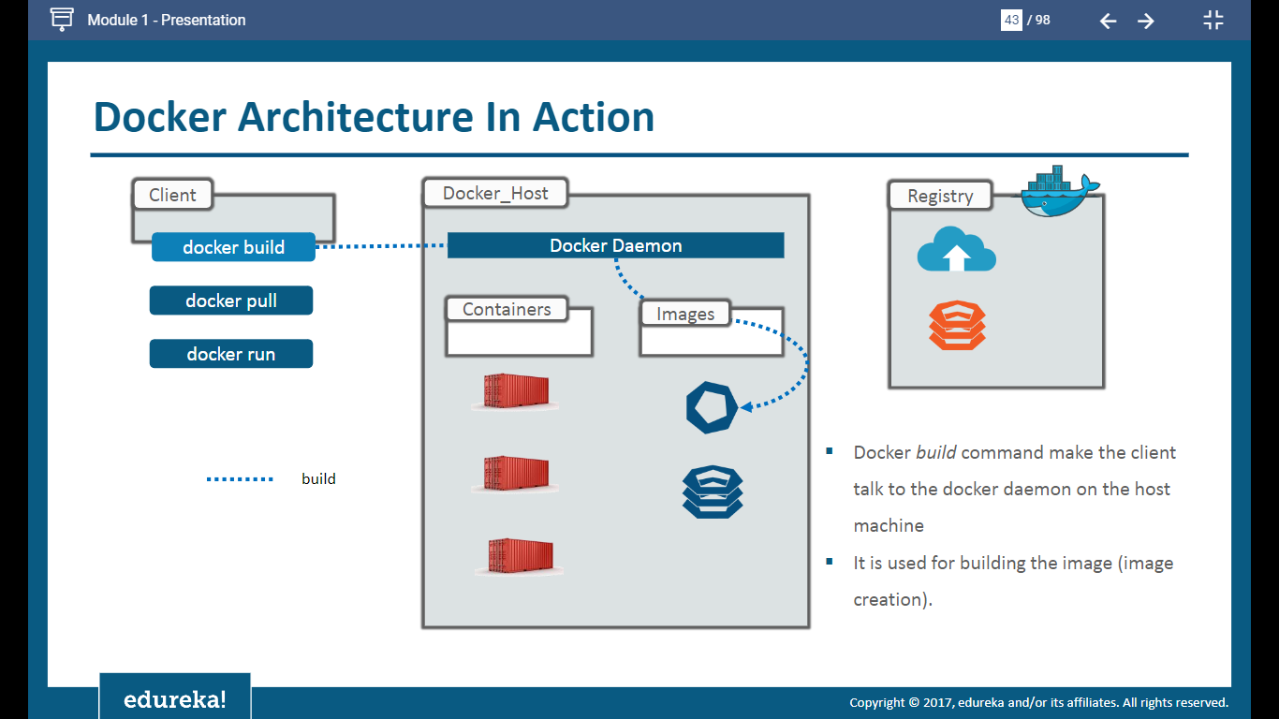

Slide 46
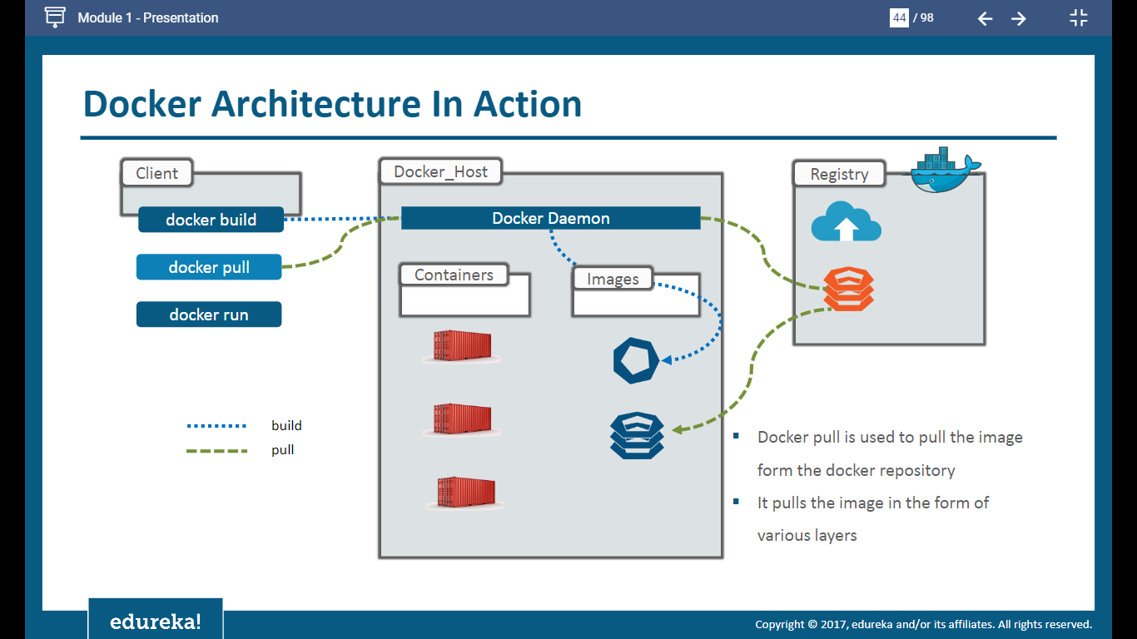

Slide 47
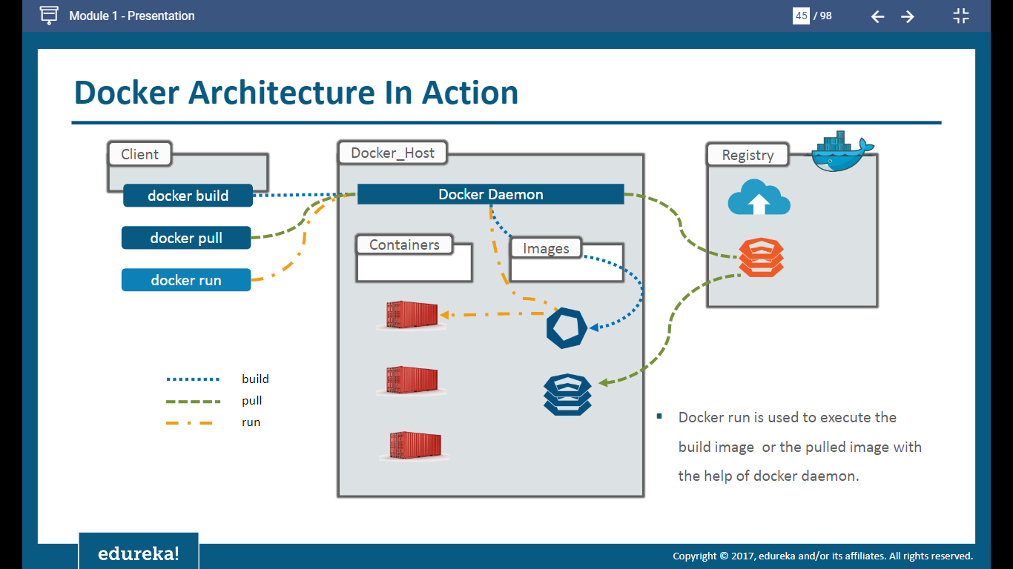

Slide 48
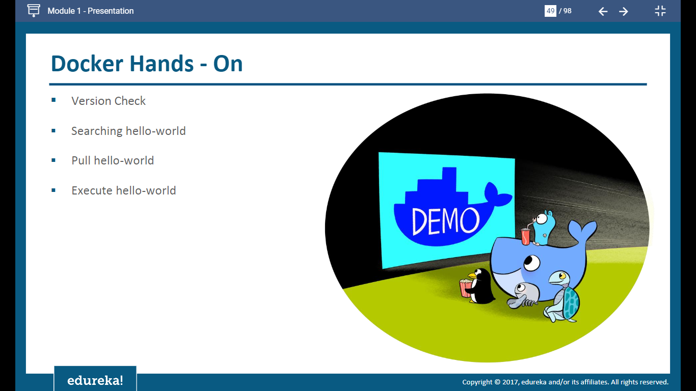

Slide 49
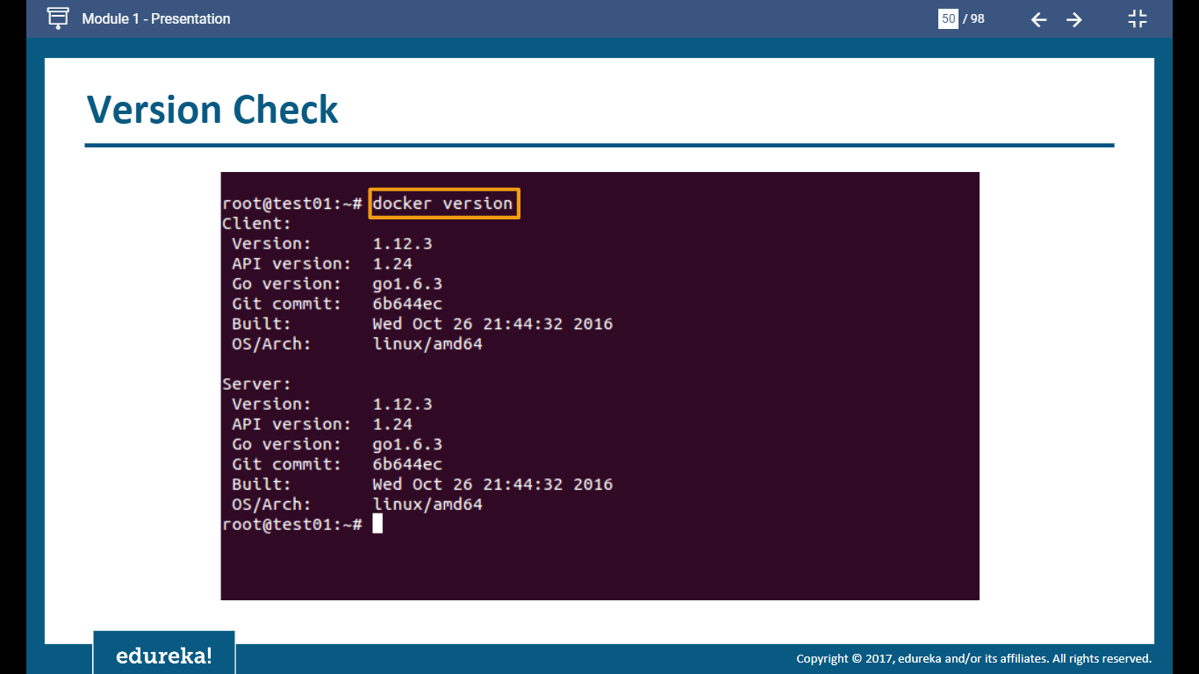

Slide 50
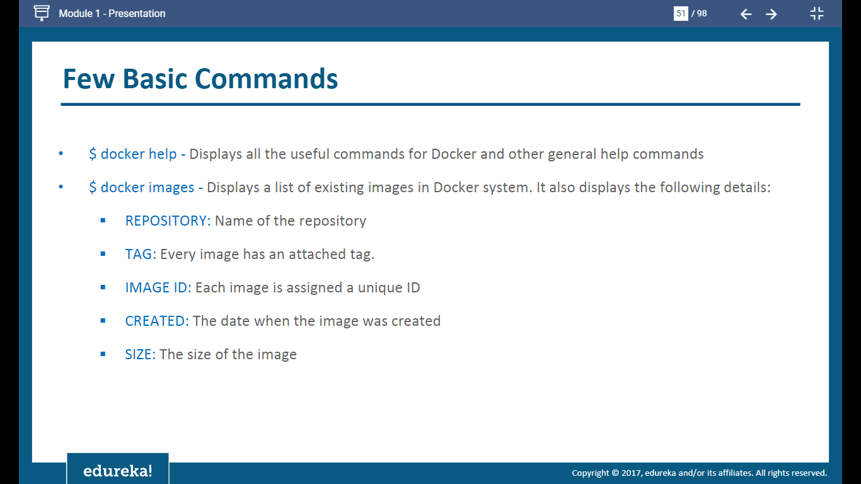

Slide 51
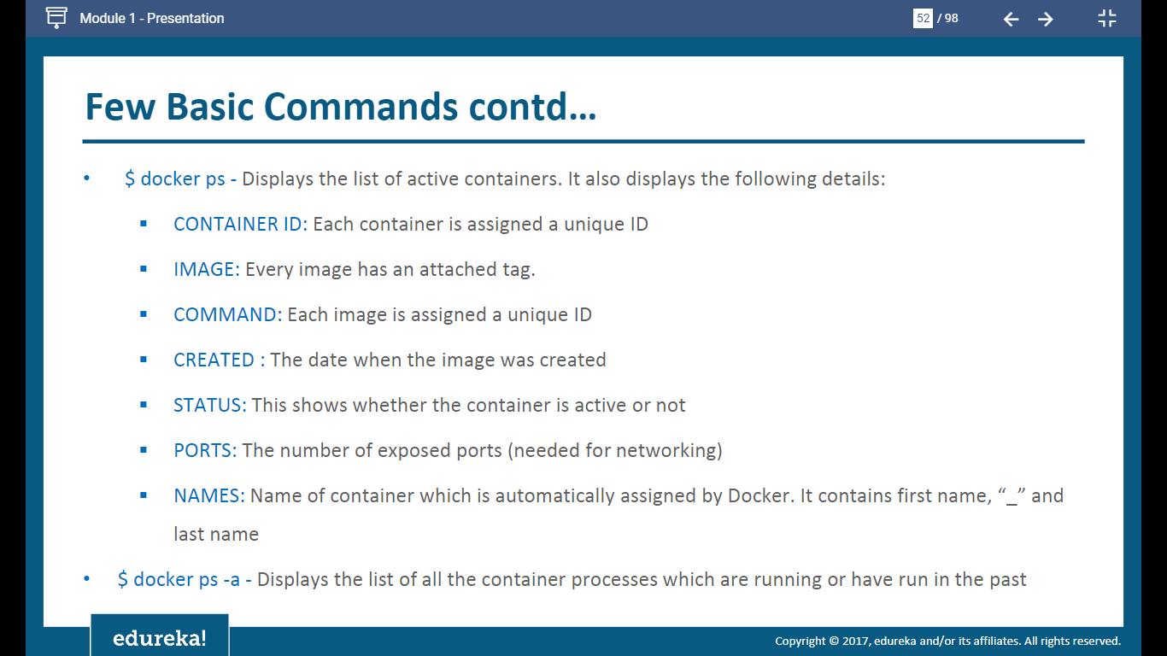

Slide 52
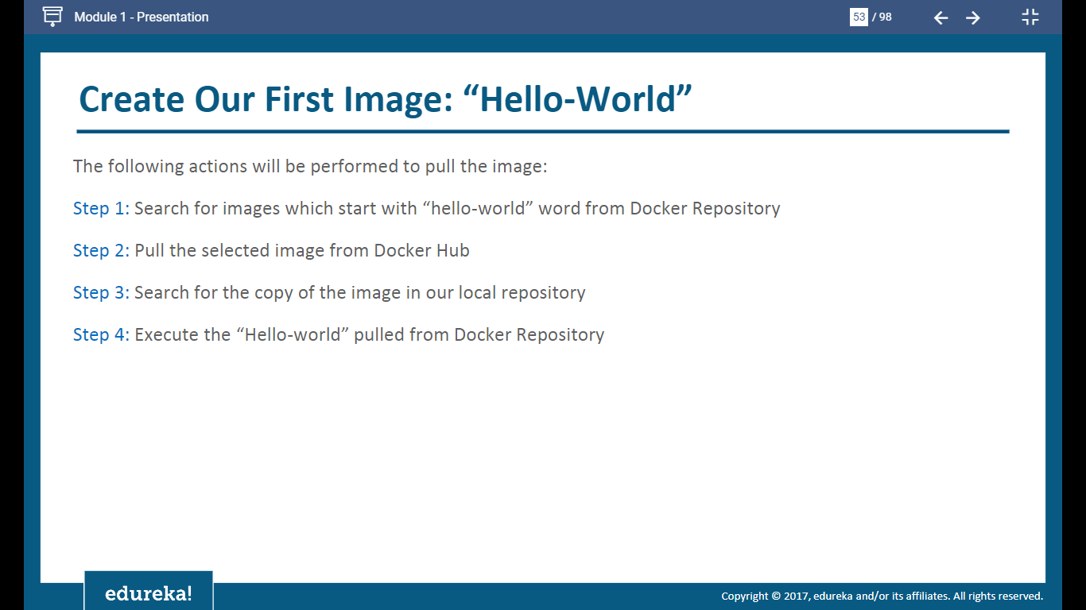

Slide 53


Slide 54


Slide 55


Slide 56


Slide 57


Slide 58


Slide 59


Slide 60


Slide 61


Slide 62


Slide 63


Slide 64


Slide 65


Slide 66


Slide 67


Slide 68


Slide 69


What does the -t or --tty do in Docker?

Slide 70


Slide 71


Slide 72


Slide 73


Slide 74


Slide 75


Slide 76


Slide 77


Slide 78


Slide 79


Slide 80


Slide 81


Slide 82


Slide 83


Slide 84


Slide 85


Slide 86


Slide 87


Slide 88


Slide 89


Slide 90


Slide 91


Slide 92


Slide 93


Slide 94


